Slide 2
REFLECT
1) WHAT DO THESE WORDS MEAN TO YOU …
HAPPINESS
KINDNESS
SUPPORT
TAKING PART
CHALLENGE

Slide 3
REFLECT
2) HOW HAPPY ARE YOU FEELING TODAY?

Slide 4
DISCUSS WITH A PARTNER
1. What do you like about this front cover?
2. Can you name another book by this author?
3. What does it mean to ‘smash’ a record?

Slide 5
Breaking a record is all about challenging yourself and can’t be done without the support of others.
DISCUSS!
Take a look at the following records and discuss which is your favourite world record and why?

Slide 6
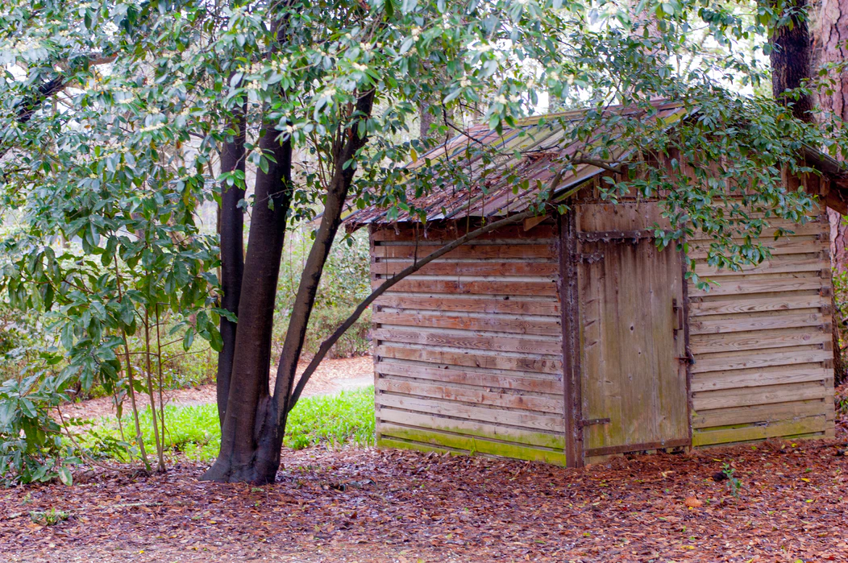
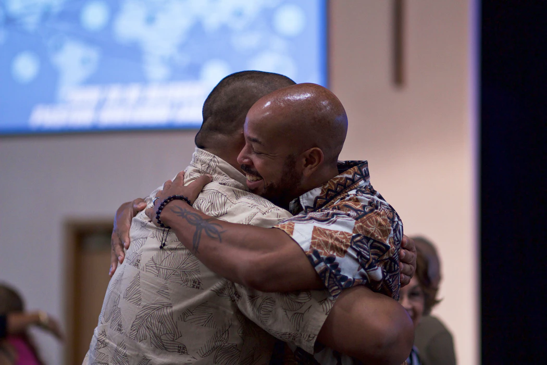
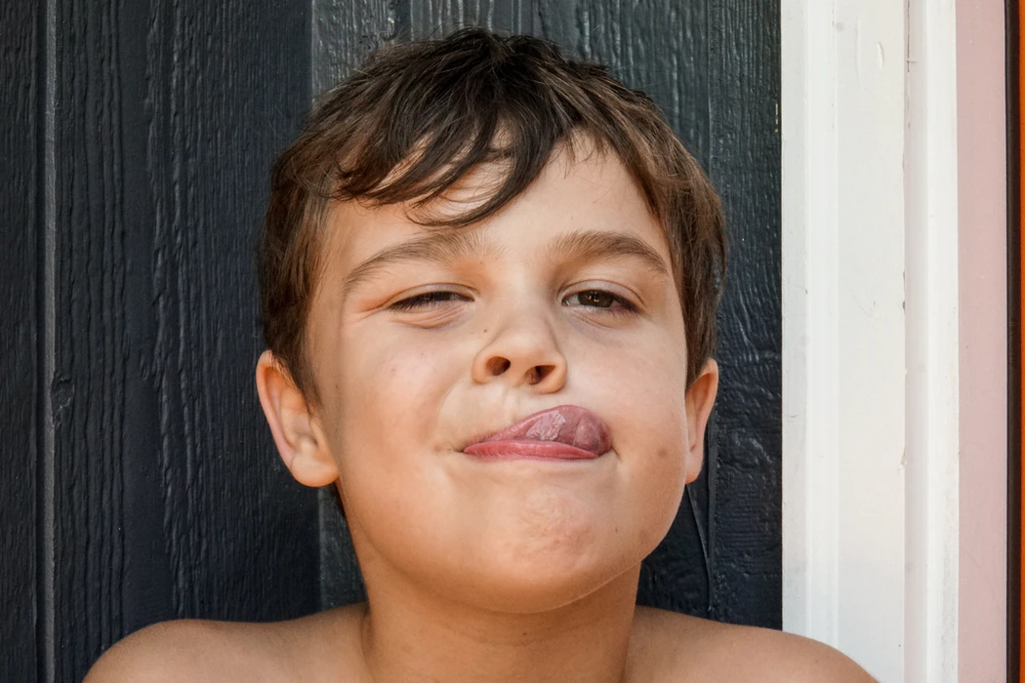
Which is your favourite world record and why?
THE FASTEST MOTORIZED GARDEN SHED HIT
170.268 KM/H
THE LONGEST EVER HUG LASTED 24 HOURS
AND 33 MINS
THE LONGEST HUMAN TONGUE MEASURES 10.1CM
THE LONGEST SELFIE RELAY CHAIN CONSISTED OF 1007 PEOPLE

Slide 7
REFLECT
What is depression? Can people be ‘fixed’?
How can Lucy show her mum kindness when she is unwell and sad?
Who else might help to support Lucy?
Can you think of a time you showed kindness recently? Who did you help?

Slide 8
CONSIDER
WHICH 3 QUALITIES ARE MOST IMPORTANT TO YOU IN A FRIEND?
Close your eyes and think of a time when…
you have shown one of these qualities
a friend showed one of these qualities
HOW ARE HAPPINESS, FRIENDSHIP, AND KINDNESS ALL CONNECTED?

Slide 9
TIME TO LOOK AT AN EXTRACT
“Just because I’ve got my own problems doesn’t mean you shouldn’t tell me about yours.”
Sandesh paused in the hallway and studied my face like he was looking right into me. “Because that’s what you do, is it, Lucy? Share your problems? Because from where I’m standing that’s an area you need to work on.”
His words were blunt, but he said them kindly.
And we both knew he was right.

Slide 10
1. What qualities do Lucy and Sandesh show in this extract?
2. What is revealed about their friendship?
3. Why is it so important to ‘share your problems’?

Slide 11
“I guess what I’ve realized is that you can’t hinge your own happiness onto one person or one thing.
Happiness comes from a lot of different places.
You just have to notice them.” Lucy
With the person sitting next to you, have a chat about all the different ‘places’ your happiness comes from …

Slide 12
IN THE CLASSROOM OR AT HOME, SKETCH YOUR OWN
RAINBOW OF HAPPINESS!
For each colour of the rainbow, note down something or someone that makes you happy.

Slide 13
At the end of the story, Lucy states that:
“The whole time I’d been trying to get onto Record Smashers, I thought I’d been searching for my mum’s happiness. But I was wrong about that. I’d really been searching for mine.”
DISCUSS
What do you think Lucy means by this?
What does Lucy realise about her mum’s love for her?
Have you ever experienced similar thoughts or feelings to Lucy?
What does it mean to be truly happy

Slide 14
Now it’s your turn to think about …
How will you support a friend when they face a challenge?
and
How can you help to make someone else happy?

Slide 15
“Those photos of Sandesh, and of me, Mum and Aunty Sheila in my canoe, are my favourite ever photos now.
I keep them under my pillow and when times get tricky and Mum’s sadness creeps back… I like to look at them and remember that moment.”
FINAL THOUGHT
Who would be in your favourite photo ever and why?
Keep your rainbow of happiness or a favourite ever photo nearby and look at them when times get tricky.

